Slide 1
Chapter 10: Brain-based Amnesia and Alzheimer’s Disease

Slide 2
Memory Loss and Aging
Amnesia: Memory loss
Many causes!
  Accidents, strokes, tumors, brain surgery
Amnesia risk increases w/ age
Notes:
Satisfies Learning Objective 1: Summarize the descriptions of amnesic patients and describe what they have in common and how they differ.
Alzheimer’s disease: The most common form of amnesia, with an approximate 360,000 cases every year.
Causes of amnesia:
Frequently results from brain damage that occurs in strokes or motor vehicle accidents.
It can also be the result of tumors, near-drowning experiences (apoxia), brain surgery, bullet wounds, and other damage to the brain.
Psychological trauma and psychiatric conditions can also lead to memory impairment.

Slide 3
What Is Amnesia?
Amnesia is broad!
Two general types:
  Retrograde vs. anterograde
Neurological amnesia:
  Results from physical destruction of brain tissue
Notes:
Satisfies Learning Objective 1: Summarize the descriptions of amnesic patients and describe what they have in common and how they differ.
Amnesia: Memory deficits acquired through brain damage.
Classification: Different disorders, with memory loss as a common factor, can be classified as amnesia.
Memory loss:
The major deficit is in encoding new information into episodic memory.
Others affect retrieval from episodic memory.
Amnesia may also affect access to semantic memory and working memory, and executive control of memory.
Neurological amnesia: Results from physical destruction of different regions of the brain.

Slide 4
Studying Amnesia
Case studies!
Famous cases:
  HM (arguable most famous)
  Clive Wearing
  KF
  PV

Slide 5
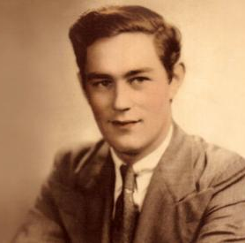
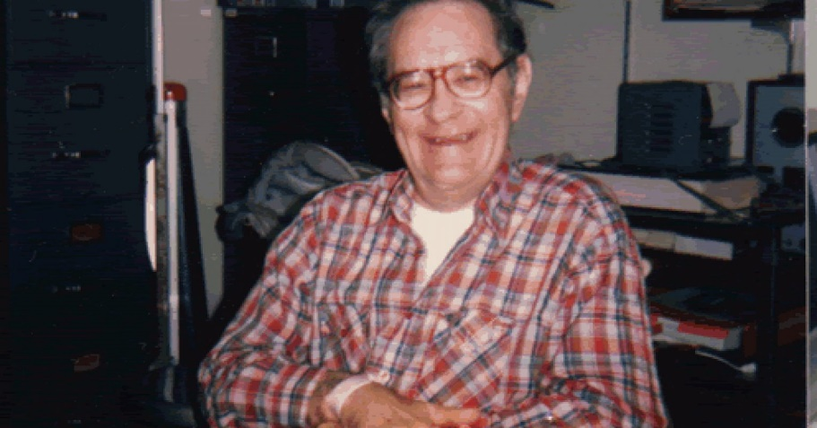
Reminder: HM
Henry Molaison (1926 - 2008)
Suffered from severe epilepsy in childhood
Age of 27, had experimental neurosurgery to remove both hippocampi
Notes:
Satisfies Learning Objective 4: Assess the role of neuropsychology in understanding the neuroscience of memory.
The case of Phineas Gage:
Phineas Gage was a survivor of an accident that left him with a brain injury, altering his cognitive and emotional abilities, as well as his personality.
The study of the change in his behavior set the stage for the development of neuropsychology.
Research goal of neuropsychology: Correlating behavioral deficits or cognitive changes with the area of the brain that is damaged.
Anterograde amnesia and retrograde amnesia:
Anterograde amnesia: An inability to form new memories following brain damage.
Retrograde amnesia: An inability to retrieve memories of events prior to brain damage.
Relation of deficits in cognition and behavior: Neuropsychologists examine these relations with the locus of damage within the person’s brain.

Slide 6
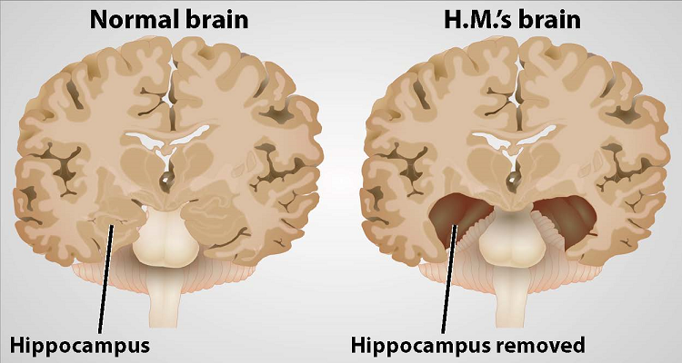

Slide 7
Case Studies of Amnesia (1 of 2)
Post-surgery life
  No issues, speaking, reading, writing, etc.
Extreme case of anterograde amnesia.
  Procedural memory intact
  Semantic memory intact
  Could not encode new events
Notes:
Satisfies Learning Objective 1: Summarize the descriptions of amnesic patients and describe what they have in common and how they differ.
Beginning: modern study of amnesia:
HM’s hippocampi was surgically removed as a treatment for epilepsy, in 1953, along with much of the surrounding medial temporal tissue.
HM’s seizures decreased, his IQ remained stable before and after surgery, and his working memory remained normal.
Post-surgery life:
His ability to speak, understand, read, and write was not impaired.
He was also able to remember much of his life from before the surgery.
His stored episodic memories were still accessible.
However, the effect on his ability to encode new information was devastating.
He was unable to remember events.
Extreme case of anterograde amnesia:
HM’s memory deficits were largely restricted to the encoding of events.
His procedural memory was intact.
HM’s symptoms led researchers to attribute anterograde amnesia to deficits in the hippocampus and surrounding temporal lobe areas.

Slide 8
Anterograde Amnesia (1 of 5)
Inability to form new memories after brain damage
Learning new information is difficult
Deficits can be quite specific
Damage is usually to the hippocampus and/or medial temporal lobes
Notes:
Satisfies Learning Objective 2: Contrast the different varieties of amnesia and how they map onto different human memory systems.
Anterograde amnesia:
An inability to form new memories following brain damage.
It can vary from mild impairment to the severe impairment seen in patients like HM.
Learning new information, episodic or semantic, becomes difficult.
Resultant deficits:
Some deficits are quite specific, that is, the person has difficulty in learning new information and encoding episodic events, while other aspects of memory remain intact.
Damage in the brain tends to be in the hippocampus and medial temporal lobes.
Hippocampus:
An area of the brain associated with learning and memory.
Damage can cause anterograde amnesia.
Medial temporal lobes:
A cortical area of the brain in the temporal lobes associated with learning and memory.
Damage can cause anterograde amnesia.
Damage can also be in the mammillary bodies of the diencephalon.
Mammillary bodies:
A subcortical region of the brain associated with learning.
Damage can cause anterograde amnesia.
Amnesic syndrome: Specific impairment of encoding new information into both episodic and semantic memory while most other cognitive functions remain intact.
Difference between hippocampal and diencephalon damages:
Patients with damage to the hippocampus and to the surrounding medial temporal lobes will show deficits on both recall and recognition tests.
Patients with damage to areas of the diencephalon will show relatively preserved performance on tests of recognition.

Slide 9
Case Studies of Amnesia (2 of 2)
Clive Wearing (1938 – Present)
Accomplished British conductor and musician
Contracted viral encephalitis in 1985 (inflammation of the brain)
Notes:
Satisfies Learning Objective 1: Summarize the descriptions of amnesic patients and describe what they have in common and how they differ.
Early life: Born in 1938, in England, Wearing enjoyed a successful musical career as a tenor, piano player, conductor, and composer.
Viral encephalitis:
Wearing contracted viral encephalitis in 1985.
Viral encephalitis is a rare but dangerous disease that causes massive swelling of the brain.
Wearing had an earlier herpes infection, and together with the encephalitis, caused massive damage to his brain, including to his medial temporal lobes and prefrontal lobes.
Severe anterograde and retrograde amnesia:
In the 35 years since his illness, he has not learned a single new thing about the world (anterograde amnesia).
He cannot remember a single event from his past (retrograde).
However, his amnesia does not extend to lexical memory.
Examples of less severe cases:
Campbell and Conway describe the problems faced by people with less severe amnesia.
These people have to find extraordinary ways to remember things in their daily lives.

Slide 10
Clive Wearing
From Wikipedia: [Wearing] knows, for example, that he has children from an earlier marriage, but he cannot remember their names.
His love for his second wife, Deborah, whom he married the year before his illness began, is undiminished. He greets her joyously every time they meet, believing either that he has not seen her in years or that they have never met before, even though she may have just left the room momentarily.
When he goes out dining with his wife, he can remember the names of food, but he cannot link them with taste, as he forgets what food he is eating by the time it has reached his mouth
Notes:
Satisfies Learning Objective 1: Summarize the descriptions of amnesic patients and describe what they have in common and how they differ.
Early life: Born in 1938, in England, Wearing enjoyed a successful musical career as a tenor, piano player, conductor, and composer.
Viral encephalitis:
Wearing contracted viral encephalitis in 1985.
Viral encephalitis is a rare but dangerous disease that causes massive swelling of the brain.
Wearing had an earlier herpes infection, and together with the encephalitis, caused massive damage to his brain, including to his medial temporal lobes and prefrontal lobes.
Severe anterograde and retrograde amnesia:
In the 35 years since his illness, he has not learned a single new thing about the world (anterograde amnesia).
He cannot remember a single event from his past (retrograde).
However, his amnesia does not extend to lexical memory.
From Wikipedia: knows, for example, that he has children from an earlier marriage, but he cannot remember their names. His love for his second wife, Deborah, whom he married the year before his illness began, is undiminished. He greets her joyously every time they meet, believing either that he has not seen her in years or that they have never met before, even though she may have just left the room momentarily. When he goes out dining with his wife, he can remember the names of food, but he cannot link them with taste, as he forgets what food he is eating by the time it has reached his mouth

Slide 11
Clive Wearing
Severe anterograde and retrograde amnesia.
  Can’t form new memories
  Can’t remember past events
  Lexical memory is still intact (no problems w/ language)
  Can acquire procedural memory via repitition
Notes:
Satisfies Learning Objective 1: Summarize the descriptions of amnesic patients and describe what they have in common and how they differ.
Early life: Born in 1938, in England, Wearing enjoyed a successful musical career as a tenor, piano player, conductor, and composer.
Viral encephalitis:
Wearing contracted viral encephalitis in 1985.
Viral encephalitis is a rare but dangerous disease that causes massive swelling of the brain.
Wearing had an earlier herpes infection, and together with the encephalitis, caused massive damage to his brain, including to his medial temporal lobes and prefrontal lobes.
Severe anterograde and retrograde amnesia:
In the 35 years since his illness, he has not learned a single new thing about the world (anterograde amnesia).
He cannot remember a single event from his past (retrograde).
However, his amnesia does not extend to lexical memory.
From Wikipedia: knows, for example, that he has children from an earlier marriage, but he cannot remember their names. His love for his second wife, Deborah, whom he married the year before his illness began, is undiminished. He greets her joyously every time they meet, believing either that he has not seen her in years or that they have never met before, even though she may have just left the room momentarily. When he goes out dining with his wife, he can remember the names of food, but he cannot link them with taste, as he forgets what food he is eating by the time it has reached his mouth

Slide 12
Anterograde Amnesia (2 of 5)
Implicit Memory: Ability to perform tasks that are influenced by a past even without being aware of the experience
Word fragment completion.
Repetition priming.
Implicit memory is not usually affected by amnesia!
Notes:
Satisfies Learning Objective 2: Contrast the different varieties of amnesia and how they map onto different human memory systems.
Implicit memory:
The preserved ability to perform tasks that are influenced by a past event without being aware of the event experience.
It results from the influence of processing on areas of the brain that are not directly involved in the episodic-memory circuits.
Word fragment completion: A participant is given some letters of a word but not all of them and must figure out the word.
Repetition priming:
The effect of presenting a stimulus on the later processing of that same stimulus.
People with amnesia show repetition priming even if they do not consciously recall the target.

Slide 13
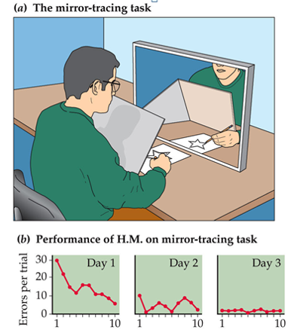
Notes:
Satisfies Learning Objective 2: Contrast the different varieties of amnesia and how they map onto different human memory systems.
Implicit memory:
The preserved ability to perform tasks that are influenced by a past event without being aware of the event experience.
It results from the influence of processing on areas of the brain that are not directly involved in the episodic-memory circuits.
Word fragment completion: A participant is given some letters of a word but not all of them and must figure out the word.
Repetition priming:
The effect of presenting a stimulus on the later processing of that same stimulus.
People with amnesia show repetition priming even if they do not consciously recall the target.

Slide 14
Anterograde Amnesia (3 of 5)
Awareness of amnesia symptoms
Patients are usually aware of their memory loss
Especially early onset Alzheimer’s patients
Memory conversations: Discussion w/ others about the past
Goal: Understand what it is like to have amnesia
Notes:
Satisfies Learning Objective 2: Contrast the different varieties of amnesia and how they map onto different human memory systems.
Self-awareness in amnesic patients:
Patients with Alzheimer’s may be acutely aware of their memory loss in the early stages of the disease, although this awareness is lost as the disease progresses.
In the amnesic syndrome, patients tend to be keenly aware of their deficits.
Memory conversations:
The discussions we have with others about the past.
First investigated by Medved who interviewed many patients with anterograde amnesia with the goal of understanding what it was like to be amnesic.

Slide 15
Anterograde Amnesia (4 of 5)
Awareness of amnesia symptoms
Memory importation: Describing a pre-amnesia event as if it happened recently
Memory appropriation: Recalling an event based on someone else’s account
Memory compensation: Deflection/changing the topic
Notes:
Satisfies Learning Objective 2: Contrast the different varieties of amnesia and how they map onto different human memory systems.
Three major coping strategies:
Memory importation: A person with amnesia describes a memory from before the injury as if it had happened after.
Memory appropriation: A person with amnesia retrieves an event based on someone else’s repeated retelling of the event.
Memory compensation: Rather than trying to answer a question about the past, a person with amnesia talks about the issues that have arisen from amnesic syndrome.
Method of vanishing cues:
Technique that uses the spared implicit memory of people with amnesia to help them learn new skills.
Was described and used by Schacter.

Slide 16
Anterograde Amnesia (5 of 5)
Simulated Anterograde Amnesia
Certain drugs can induce temporary states of amnesia
Benzodiazepines: Relive anxiety, insomnia, and muscle tension
People under the influence can have normal conversations/retrieve well-learned information but have problems encoding new information
Notes:
Satisfies Learning Objective 2: Contrast the different varieties of amnesia and how they map onto different human memory systems.
Temporary forms of amnesia: They can be induced by particular drugs.
Benzodiazepines:
Drugs that are used usually to relieve anxiety, insomnia, and muscle tension.
They are also strong amnesia-inducing drugs, especially within the episodic memory domain.
People under influence can converse normally and retrieve well-learned information, although encoding new information is impaired, particularly into episodic memory.
Attackers, particularly in date-rape situations, give benzodiazepines, especially flunitrazepam.
Their effects on short-term memory and semantic memory are mixed, depending on the specific drug and the specific task.
Anosognosia:
The failure to become aware of a cognitive deficit.
It is distinct from the amnesic syndrome, which is characterized by awareness of the amnesia.

Slide 17

Retrograde Amnesia (1 of 3)
Lost ability to retrieve prior events
Case of Trevor Rees-Jones
Loss of memory:
  Ribot’s Law: Newer memories will be more affected than older memoires
  Consolidation: Memory traces are made permanent
  Physical trauma may interrupt this process
Notes:
Satisfies Learning Objective 2: Contrast the different varieties of amnesia and how they map onto different human memory systems.
Retrograde amnesia:
When patients lose the ability to retrieve memories of events prior to brain damage.
In most cases, the inability to retrieve from memory is limited to episodic memory.
Typically, it is not complete.
The period from which memories cannot be recalled may be small and the consequences relatively inconsequential, or it may stretch back for many years.
The case of Trevor Rees-Jones:
He was the only survivor of the tragic car crash that killed Princess Diana.
Although he made a full recovery from the auto accident, with no long-term deficits in his physical or cognitive abilities, the head injury did create a window of retrograde amnesia from the time of the accident to several hours before.
Loss of memory:
Occurs for events closest to the point of brain damage.
Ribot’s law: Newer memories will be more affected by retrograde amnesia than older memories.
Consolidation: A neurological process whereby memory traces are made permanent in a person’s long-term memory.
The period of retrograde amnesia can be quite short in relatively minor injuries.
Existing research:
Lynch and Yarnell observed that football players, who suffered from concussions during games, could no longer remember the play in which they had gotten injured.
In case of permanent brain damage, the retrograde period can remain lengthy and unchanged for the rest of the person’s life.

Slide 18
Retrograde Amnesia (2 of 3)
Difficult to pinpoint exact brain region causing retrograde amnesia
  Seen in damage to the diencephalon, frontal lobes, and medial temporal lobes
Temporal lobe epilepsy often produces retrograde amnesia for moments immediately before and after a seizure
Notes:
Satisfies Learning Objective 2: Contrast the different varieties of amnesia and how they map onto different human memory systems.
Neurological effects:
It is difficult to pinpoint the exact locus in the brain that causes retrograde amnesia.
It is seen in cases of amnesia related to damage to the diencephalon, damage to the frontal lobes, and damage to the medial temporal lobes.
The role of the hippocampus is debatable, with some arguing that damage to the hippocampus results in a restricted time-limited retrograde amnesia, and others suggesting that it could be because of the damage to the surrounding medial temporal lobe.
Temporal lobe epilepsy:
Epilepsy is a disease in which damaged brain tissue results in abnormal neuronal discharging, resulting in seizures.
The temporal lobe, critical to memory processes, is the focal point of the brain damage that causes epilepsy.
Epilepsy patients will often demonstrate retrograde amnesia for a seizure and some time before the seizure.
Role of clinical neuropsychologists:
Clinical neuropsychologists can run tests to examine a person’s cognitive and emotional skills.
If the scores on these tests are poor, the neuropsychologist may diagnose a memory problem.

Slide 19
Retrograde Amnesia (3 of 3)
Electroconvulsive Therapy: A treatment for depression that involves delivering a strong shock to the patient’s head
Retrograde amnesia is a side effect
  Up to one year before the shock
  Both episodic and semantic memories
  Memory loss linked to improved mood?
  Does not cause anterograde amnesia
Notes:
Satisfies Learning Objective 2: Contrast the different varieties of amnesia and how they map onto different human memory systems.
Electroconvulsive therapy (ECT):
An effective treatment for depression that involves delivering a strong electric shock to the head of a patient.
It creates periods of retrograde amnesia.
Side effects:
Retrograde amnesia is one of the side effects of ECT.
The retrograde period may extend to up to one year or more before the shock, for both episodic as well as semantic memories.
Recent improvements in ECT have reduced the amount of retrograde amnesia, with the effect wearing off once the sessions are complete, in most cases.
Some believe that the memory loss itself creates improved mood in patients who can no longer recall what is depressing them so much.
ECT does not seem to cause anterograde amnesia.

Slide 20
Transient Global Amnesia
A rare form of amnesia that is extremely short lived
TGA episode produces retrograde amnesia lasting a few hours to several years into the past
Sudden onset, no loss of identity, most likely to affect middle to early old age individuals
Notes:
Satisfies Learning Objective 3: Assess the consequences of different kinds of brain damage on different set of symptoms, such as why Korsakoff’s disease differs from other forms of amnesia.
Transient global amnesia:
A rare form of amnesia in which the amnesic effects are short-lived, usually on the order of hours.
The amnesic effects are extremely strong, although they last for a short time and completely disappear.
There might not be any long-term effects either.
Characteristics:
A dense, anterograde amnesia.
Retrograde amnesia for a few hours into the past to several years into the past during the TGA episode.
According to Hainselin et al., although patients with TGA are aware that there is a problem, they are not aware of the extent of their amnesia.
Onset and attacks:
Onset is sudden.
There is no loss of personal identity.
Working memory also appears unimpaired.
More in people from middle age to early old age, decreasing again in older adults.
A history of migraines is associated with TGA attacks in younger people.
Can be triggered by rigorous exercise or physical stress, as well as psychological stress.
Etiology: Hunter suggested that the most likely explanation for TGA is ischemia, a temporary disruption of blood flow within the brain.

Slide 21
Short-Term Memory Amnesia
Deficits in working memory capacity
Patient KF:
  Motorcycle accident left him w/ severe damage to frontal lobe of left hemisphere
  Selective impairment of short-term memory
Patient PV
  Damage to the phonological loop
  Problems with working memory for auditory information
Notes:
Satisfies Learning Objective 3: Assess the consequences of different kinds of brain damage on different set of symptoms, such as why Korsakoff’s disease differs from other forms of amnesia.
Short-term memory amnesia: Deficits in the capacity of working memory.
Earliest study by Shallice and Warrington:
The researchers worked with a patient, KF, a young man who injured his head in a motorcycle accident.
He suffered from a selective impairment of short-term memory.
He suffered extensive damage to the frontal lobe of the left hemisphere, close to the Sylvan fissure, an area associated with language formation and processing.
Later study by Vallar and Baddeley:
The researchers studied a patient, PV, who seemed to have selective damage to the phonological loop.
She showed deficits in digit span tasks, when the items were presented in an auditory format.
PV had damage in the parietal lobe in the left hemisphere, near the back of the frontal lobes.

Slide 22
Reduplicative Paramnesia and Capgras Syndrome
Reduplicative paramnesia: Patients believe that places or locations have been duplicated
Capgras syndrome: Patients believe that other people have been duplicated
Notes:
Satisfies Learning Objective 3: Assess the consequences of different kinds of brain damage on different set of symptoms, such as why Korsakoff’s disease differs from other forms of amnesia.
Reduplicative paramnesia:
A condition caused by brain damage in which patients believe that places or locations have been duplicated and that the two locations exist simultaneously.
Occurs after traumatic brain damage, not from schizophrenia or other psychiatric disorders.
Capgras syndrome: A condition caused by brain damage in which patients believe that other people have been duplicated and that two identical people may exist.
Arguments by Hinkebein et al.:
Two neurological deficits combine to create the symptoms seen in reduplicative paramnesia.
Damage to areas in the right parietal lobe creates impaired visual perception and visual memory.
Bilateral damage in the prefrontal lobes prevents the individual from experiencing familiarity or dismissing its lack as an illusion.
Evidence from research:
Hermanowicz described a striking case of a 73-year-old man suffering from retinitis pigmentosa had begun to suffer from visual hallucinations at age 71.
Ryan and Caplan described another case of Capgras syndrome in which 71-year-old had prefrontal damage from a potential variety of causes, including earlier brain trauma, psychiatric illness, and heavy alcohol use.
Capgras syndrome is more associated with psychiatric conditions, such as schizophrenia.
According to Ramachandran and Blakeslee, Capgras syndrome arises from a breakdown in the connections between the temporal lobe areas and the limbic system.

Slide 23
Memory loss and Aging
Age
  The amount of time (typically in years) following birth, chronological
Is this appropriate?
  Number of gray hairs
  Number of wrinkles
  Changes to BMI

Slide 24
What is Age?
Aging causes nothing
  “Aging” is a process that correlates with the passage of time
  Aging is not causation, though often assumed
  Not a tangible object or structure (i.e., no random assignment)
We use Chronological Age (Time) to infer aging effects

Slide 25
Developmental Trajectories
Cognitive Factor X
Chronological Age

Slide 26


Slide 27
Why declines in episodic memory?
Attentional declines
  Deliberate mental effort must be allocated in order to remember something
Ineffective Retrieval Cues
  We can remember anything with the right cues (reminders)!
  As we age, our ability to bring cues online declines
  Example: Tip-of-the-tongue phenomenon

Slide 28
Age Theories of Attention
Why are there age-related differences?
  1.) Processing Resources Hypothesis
  As we get older, we generally have fewer processing resources available
    Processing resources = number of mental operations

Slide 29
Age Theories of Attention
Why are there age-related differences?
  2.) Cognitive Slowing (Speed of Processing Hypothesis; Salthouse, 1996)
    General slowing of cognitive processing
    Older adults are 1.5 times slower on responding on some tasks (Myerson et al., 1992; Salthouse, 1985)

Slide 30
Dementia
No a single disease, used more to describe symptoms
  1.) Huntington’s disease
    Strong genetic base
  2.) Parkinson’s disease
  3.) Head trauma
  4.) Alzheimer’s Disease

Slide 31
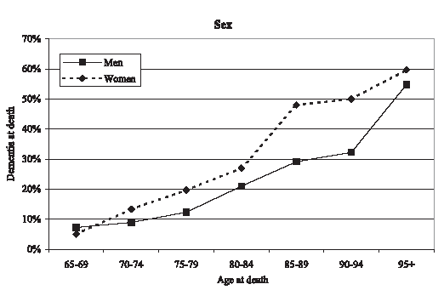
5.2 million Americans 65+ have been diagnosed with dementia-like symptoms (2016 estimate)
By the age of 95 100% of individuals at autopsy have pathology consistent with Alzheimer’s Disease (Morris, 1995)

Slide 32
Alzheimer’s Disease (AD)
Most common form of dementia
  Progressive
  Degenerative
  Fatal
    In about 60% of cases
  Can only be diagnosed post mortem
    Changes in brain structure are microscopic
    Dementia of the Alzheimer’s Type (DAT)
    Affects 24 Million worldwide, estimated to affect 80 million by 2040 (Bateman et al., 2011)

Slide 33
Alzheimer’s Disease (1 of 5)
Typical pattern of deterioration:
  Memory decline is first symptom
  Followed by general cognitive problems
  In the latest stages, physical systems rapidly decline
Earliest stages of disease:
  Patient recognizes that their memory “isn’t what it used to be”
  Hard to distinguish from healthy aging
  Neurotesting can distinguish (deficits in WM)
Notes:
Satisfies Learning Objective 4: Explain what causes Alzheimer’s Disease is and how it develops in terms of its debilitating symptoms for people suffering from it.
Alzheimer’s disease:
A dementia-type illnesses that are more common in older adults than in younger adults.
It is caused by amyloid plaques and neurofibrillary tangles throughout the brain.
Memory is the first deficit detected in this disease.
It is the sixth leading cause of death in the United States.
Typical pattern of deterioration:
Memory decline is the first symptom.
These are followed by more general cognitive problems.
In the latest stages, physical systems decline rapidly.
Earliest stages of disease:
In the earliest stage of the disease, the patient will recognize that his or her memory is “not what it used to be.”
In this stage, memory deficits may be difficult to distinguish behaviorally from normal age-related declines in memory.
Neuropsychological tests can often distinguish between the two, with Alzheimer’s patients showing deficits in working memory performance.
Patients also do not show normal recency effect on free-recall tasks.

Slide 34
Alzheimer’s Disease (2 of 5)
Intermediate stages.
  Cognitive deficits increase
  More anterograde amnesia
  Problems w/ language and decision making
Increase in retrograde amnesia.
  Temporal gradient: More recent information is lost first
Notes:
Satisfies Learning Objective 4: Explain what causes Alzheimer’s Disease is and how it develops in terms of its debilitating symptoms for people suffering from it.
Intermediate stages:
Mounting of cognitive deficits.
Stronger growth of anterograde amnesia.
Retrograde amnesia may also occur.
Problems in decision-making and language may arise.
Motor deficits are also experienced.
Increase in retrograde amnesia: Characterized by a temporal gradient, with more recent information being lost before older information.
Late stages of disease:
With motor movement now difficult, the patient is completely dependent on caregivers.
Memory declines to the point that the patient no longer appears to recognize even close family members.
In many cases, the patient will no longer respond to hearing his or her own name.
The patient may also lose all access to language and be unable to either speak or understand others.
Patient usually dies of external factors, such as pneumonia, rather than the Alzheimer’s disease itself.

Slide 35
Alzheimer’s Disease (3 of 5)
Late stages of disease:
  Motor problems/difficulty with movement
  Patient no longer recognizes close family members
  No longer responds to their own name
  Patient dies of external factors rather than AD itself
Notes:
Late stages of disease:
With motor movement now difficult, the patient is completely dependent on caregivers.
Memory declines to the point that the patient no longer appears to recognize even close family members.
In many cases, the patient will no longer respond to hearing his or her own name.
The patient may also lose all access to language and be unable to either speak or understand others.
Patient usually dies of external factors, such as pneumonia, rather than the Alzheimer’s disease itself.

Slide 36
Cognitive Symptoms
Gradual changes in cognitive functioning:
  Declines in attention
  Declines in memory
  Declines in judgment/decision making
  Disorientation in time/space
Does attention moderate all of these other behaviors?

Slide 37
Declines in Attention
Stroop Task
  Errors on Incongruent trials predict DAT conversion (Hutchison et al., 2010)
  The Stroop effect (slower RTs on incongruent trials) does not
CVOE Switch Task
  Errors on Switch trials predict DAT conversion (Huff et al., in prep)
  Switch costs in RT, do not
Trials that are the most difficult are sensitive to breakdowns in attentional control

Slide 38
Other Symptoms
Sundowning (“as the sun goes down”)
  Symptoms of AD are generally worse in the evening than in the morning
Declines in Activities of a Daily Living (ADLs)
  Personal hygiene, toileting, eating, transfer (walking/mobility)
Changes in personality
Inappropriate social behaviors

Slide 39
Characteristics of AD
Abnormal/Rapid Cell Death
  Frontal Lobe
  Hippocampus
  Cortex

Slide 40
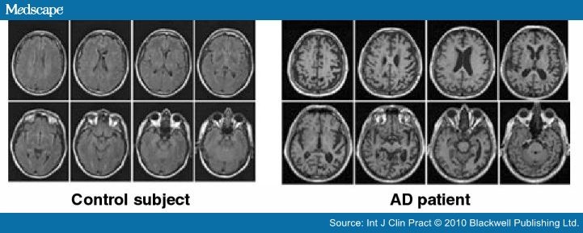
Characteristics of AD

Slide 41
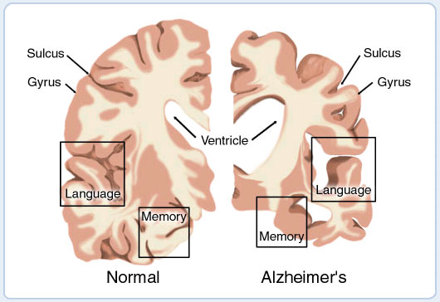

Slide 42
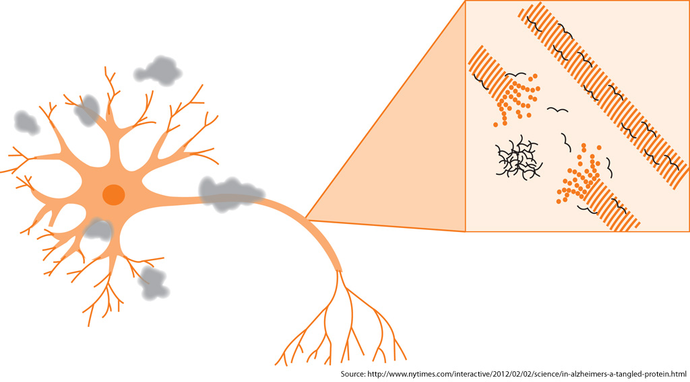

Slide 43
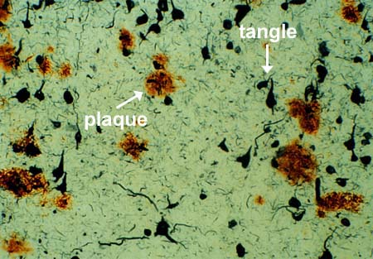
Characteristics of AD
Neuritic plaques
  Beta-amyloid plaques
  Peptide that is surrounded by dead or dying neurons
  Marker for AD

Slide 44
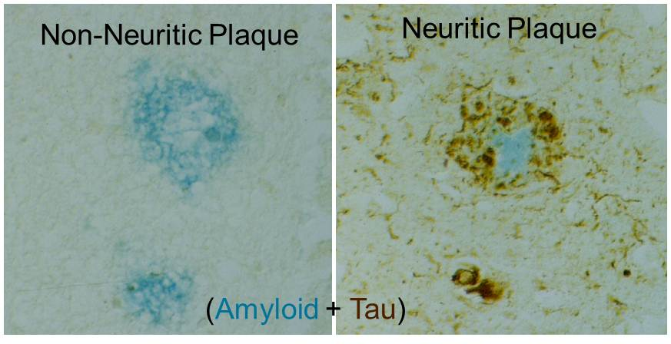
Neuritic Plaques

Slide 45
Alzheimer’s Disease (3 of 4)
Causes of Alzheimer’s Disease
Genetic component: Risk is 50% for identical twins if one twin has already developed it
Changes to the brain’s cholinergic system:
  Brain has difficulty producing acetylcholine, which is important for learning and memory
Notes:
Satisfies Learning Objective 4: Explain what causes Alzheimer’s Disease is and how it develops in terms of its debilitating symptoms for people suffering from it.
Genetic component:
It increases the likelihood getting it someday than someone without a close relative with Alzheimer’s disease.
The risk of developing Alzheimer’s disease is 50% for a person whose identical twin has already developed it.
Incredible stress on the brain:
Neural degeneration in the cerebral cortex gradually spreads to subcortical areas.
Dense amyloid plaques form throughout the cortex.
Amyloid plaques: Masses of unnecessary proteins that interfere with normal brain function.
Neurofibrillary tangles: The twisting of amyloid plaques around neurons, which causes destruction of those neurons.
Changes to the brain’s cholinergic system: The brain has difficulty producing the neurotransmitter acetylcholine, used in many of its learning and memory circuits.

Slide 46
Characteristics of AD
Neurofibrillary tangles
  Misfolded proteins (filaments) within the neuron
    Direct relationship with dementia is unknown
    Marker for AD

Slide 47
Alzheimer’s Disease (4 of 4)
Treatment of Alzheimer’s Disease
Prevention: Not 100% guaranteed
  Intellectually challenging activities may lower risk
  Active social life is also related to lower risk
  Healthy, low cholesterol diet
Treatment:
  Drugs attempt reduce the rate that acetylcholine is broken down
  Drug effects are temporary
  Current research emphasizes drugs that will inhibit amyloid plaques
Notes:
Satisfies Learning Objective 4: Explain what causes Alzheimer’s Disease is and how it develops in terms of its debilitating symptoms for people suffering from it.
Prevention:
Prevention is not 100% guaranteed.
Lifelong involvement in intellectually challenging activities lowers the risk of Alzheimer’s disease.
An active social life is also associated with a lower risk of developing Alzheimer’s disease.
These activities spur the growth of synapses in the brain.
Healthy, low-cholesterol diets are correlated with lower rates of the disease.
Hypertension, high cholesterol, diabetes, and smoking are all correlated with higher rates of Alzheimer’s disease.
Treatment:
Alzheimer’s drugs work by reducing the rate at which acetylcholine is broken down (destroyed) in the brain.
This will lead to temporary improvements in memory and cognitive processes, although, in the long run, the drugs cannot slow the process down.
Ongoing research focuses on finding drugs that will inhibit, reverse, or prevent the forming of the amyloid plaques.
Mild magnetic stimulation of the brain can cause temporary improvements of cognitive function in Alzheimer’s patients.

Slide 48
Drug Treatments
Proactive drug types, prevention of misfolded tangles and eliminating plaques when detected early
  Bapineuzumab – Pfizer (2012)
    Drug failed, Placebo > Experimental Drug
  Gantenerumab – Roche (2015)
    Drug failed, Placebo = Experimental Drug
  Solanezumab – Lily (2016)
    Drug failed, Placebo = Experimental Drug
Why so many failures?

